Slide 1

Department of Information Science and Engineering
Academic year: 2022-23
Project Phase - II – Review II Presentation
Project Title
PROJECT TEAM:
1. Prajwal B (1DB19IS060)
2. Prekshith Hegde D J(1DB19IS063)
3. R Adarsh Kumar (1DB19IS066)
4. Srustik B T (1DB19IS089)
GUIDE:
Mrs R Yashodara
Assistant Professor
Department of ISE
DBIT, Bengaluru

Slide 2
Contents
Index
Introduction
Problem Statement
Objectives
prototype design/model
progress of the work done after coding
code execution
Testing Methodologies Used
Implementation / Techniques used and End User Applications
out put discussion (accuracy in %)
Organization of Report ( index to be shown )
Conclusion
Future Enhancement
References

Slide 3
Introduction
Scholars and researchers from numerous academic backgrounds have been drawn to the topic of financial market modelling and forecasting. The financial market is an abstract concept whereby a buyer and seller exchange financial commodities including stocks, bonds, precious metals, and cryptocurrency.
We employ financial data instead of daily data in this research to lower the likelihood of uncertain noise and to expand the sample size over a short period.
All fluctuations in financial market values are dependent on current economic events or news. Investors are profit-driven, and their purchasing and selling decisions are based on current events rather than previous analysis or plans.
Humans, are irrational beings. Decisions are impacted by cognitive biases or emotional emotions without quantitative, data-driven models, resulting in avoidable losses.
Inspired by the growing popularity of deep learning algorithms for predicting applications, these algorithms could be used to uncover hidden patterns in the trajectory of asset values, providing additional information to retail investors when making investment decisions.

Slide 4

The aim of the proposed system is to develop a system of improved facilities. The proposed system can overcome the limitations of the existing system. The objectives of the proposed system are:
Security of data.
Ensures data accuracy.
Minimize manual data entry.
Minimum time needed for various processing.
Greater efficiency.

Slide 5
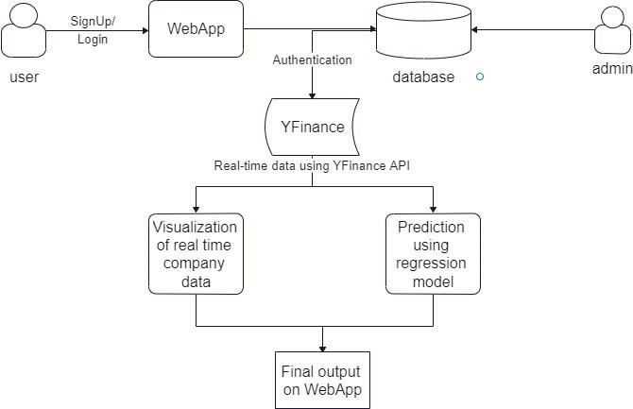
Prototype design/model
System architecture

Slide 6

progress of the work done after coding
 | NOV | DEC | JAN | FEB | March | APRIL | MAY
Planning
Literature survey
Design
Implementation
Testing
Deployment
Documentation Report

Slide 7
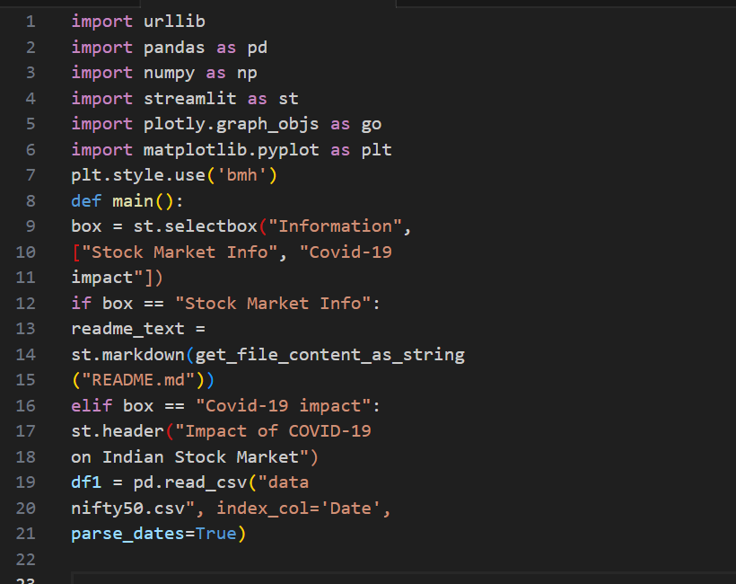
code execution

Slide 8
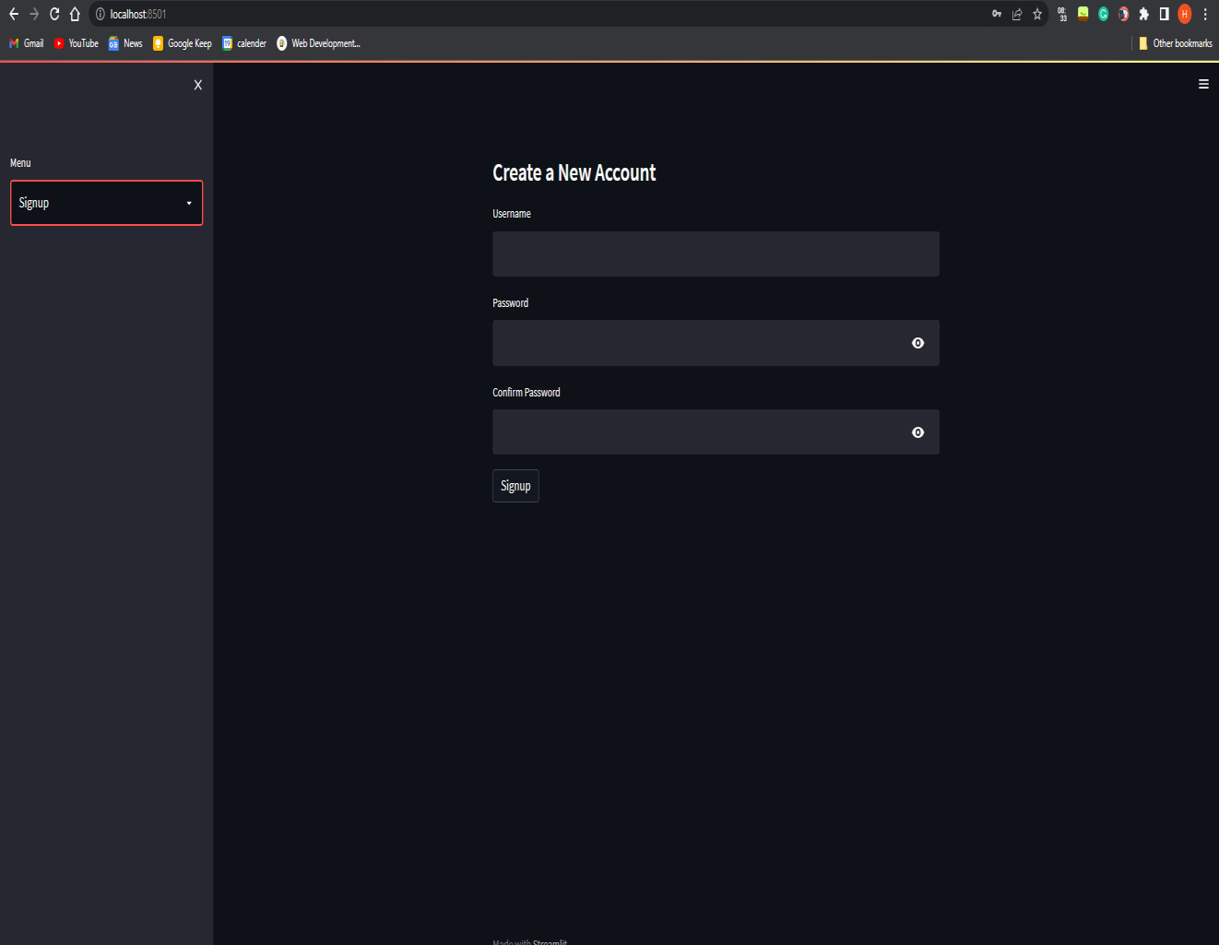
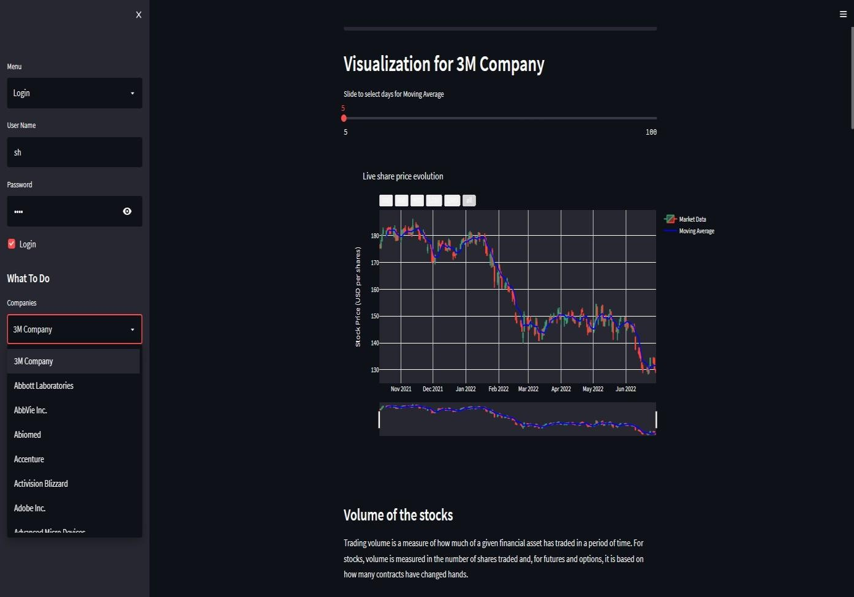
Out put Snapshots
Fig 4 : LOGIN SITE
Fig 5: Site

Slide 9
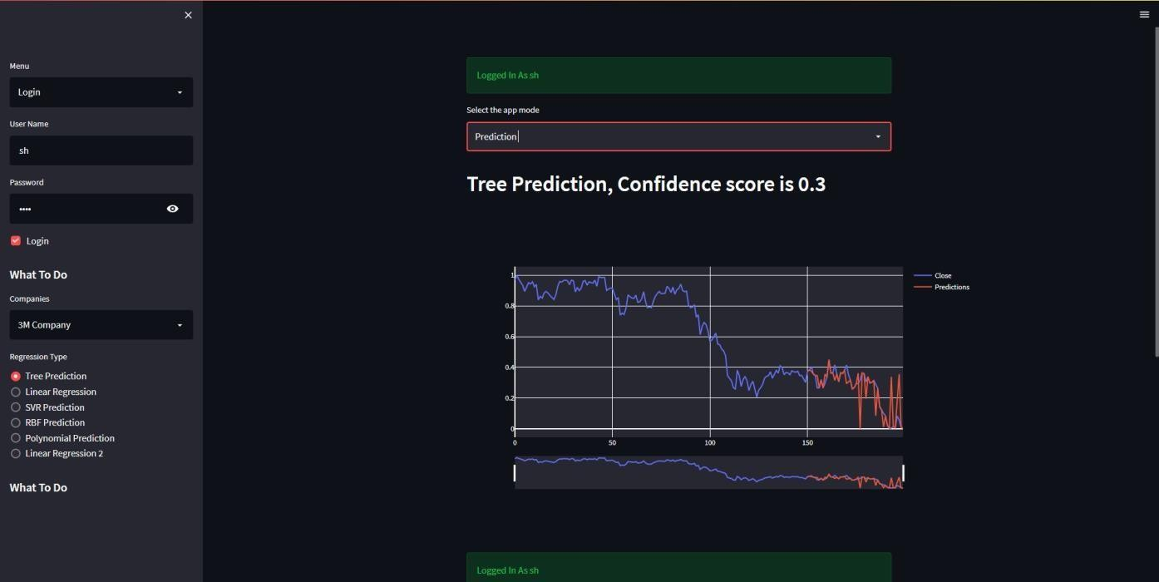
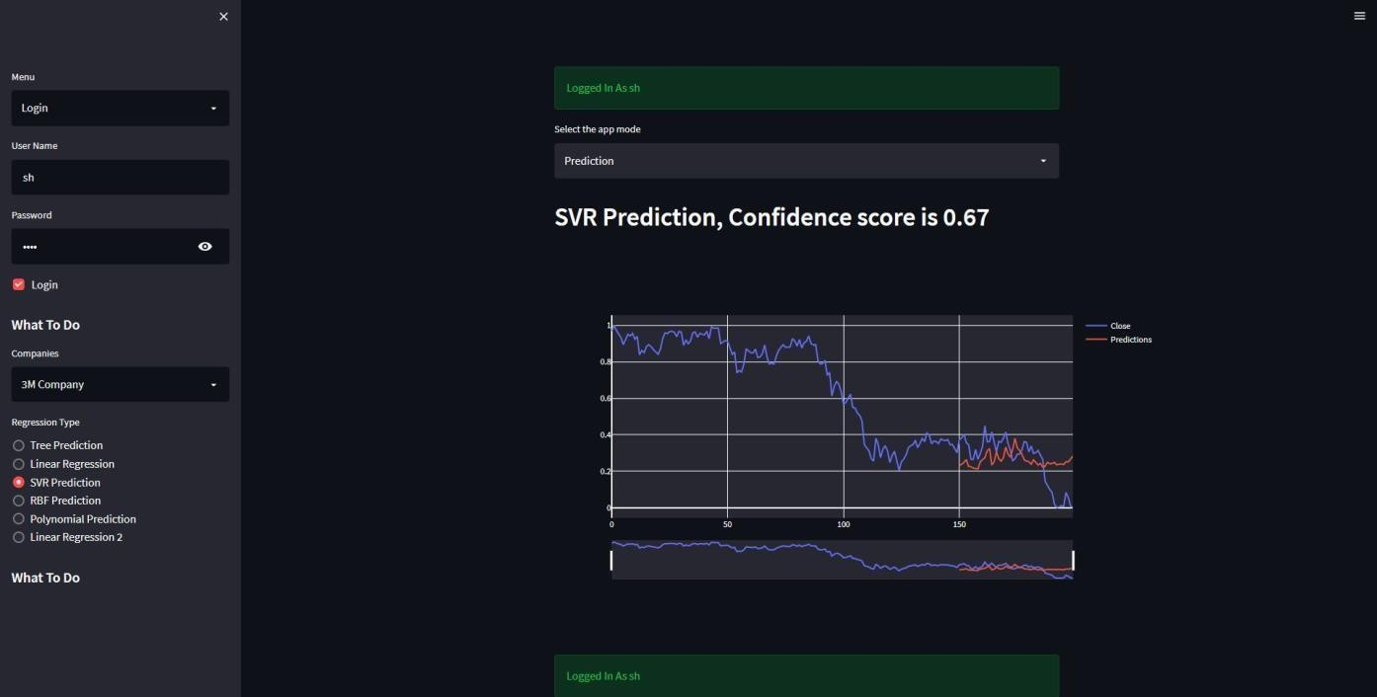
Snapshots

Slide 10
Testing Methodologies Used
Select Company
Pre-processing
Linear and tree regression
SVR and Polynomial regression
Prediction
Accuracy / Confidence Score

Slide 11
Implementation / Techniques used and End User Applications
Hardware Requirements:
1.Computer – Processor, high speed is preferred. 32/64 - bit
2. RAM 4GB
3. Hard disk – 60GB and above
4. DISK SPACE : 500 MB
Software Requirements:
OPERATING SYSTEM : Microsoft Windows 7/8/10 (32 or 64 bit) or Mac OS X 10.8.5.
PYTHON AND ANACONDA
GIT BASH
BACK-END : Python3
FRONT-END : Stream lit

Slide 12
Conclusion
The use of recently emerging machine learning algorithms to stock prediction has generated encouraging results, paving the way for their implementation in profitable exchange systems. It has led to the conclusion that utilizing machine learning techniques, it is possible to predict the stock market with greater accuracy and efficiency. The related asset's prediction system can be improved in the future by using a considerably larger dataset than the one now in use. This would aid in improving the precision of our prediction models. In addition, additional Machine Learning models could be researched to see what accuracy rate they provide.

Slide 13
Future Enhancement
Data visualization is an important tool for analyzing time-tradable assets such as stocks, commodities, and currencies. Machine learning algorithms can also be used to enhance the analysis and provide more accurate predictions of future asset prices.
One potential enhancement is to incorporate more data sources into the analysis, such as news articles and social media sentiment. Natural language processing (NLP) techniques can be used to extract relevant information from these sources and incorporate it into the analysis.
Another enhancement is to use deep learning algorithms, such as neural networks, to analyze the data and make predictions. These algorithms can identify patterns and relationships in the data that may not be apparent to human analysts

Slide 14
References
McNally S, Roche J, Caton S. Predicting the price of bitcoin using machine learning. In: Proceedings—26th Euromicro international conference on parallel, distributed, and network-based processing, PDP 2018. pp. 339–43
Fischer T, Krauss C. Deep learning with long short-term memory networks for financial market predictions. Eur J Oper Res. 2018;270(2):654–69.
Long W, Lu Z, Cui L. Deep learning-based feature engineering for stock price movement prediction. Knowl Based Syst. 2018;164:163–73.
Kara Y, Acar Boyacioglu M, Baykan ÖK. Predicting direction of stock price index movement using artificial neural networks and support vector machines: the sample of the Istanbul Stock Exchange. Expert Syst Appl. 2011;38(5):5311–9.

Slide 15


